Slide 1
High Performance Computing using OpenMP
Distributed and Parallel Technology
Yun Wu

Slide 2
Course Overview
Greeting
Version History, OpenMP in Nutshell, Objectives
Getting Our Feet Wet
OpenMP programming model (interface, execution, memory, …), compiling and execution
Diving In
Work sharing, data scoping, synchronization, runtime control
Profiling, optimization (false sharing)
Swimming Like a Champion
Matrix Vector Multiplication , Approximation of PI

Slide 3
Greeting

Slide 4
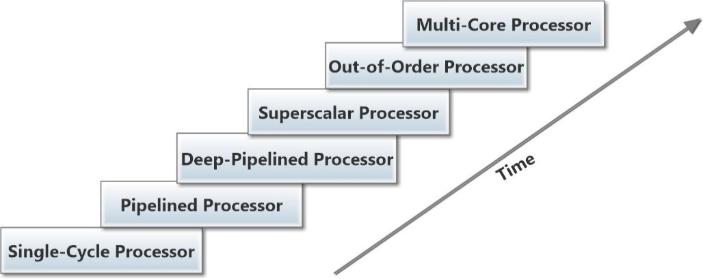
Version History
Early
Fortran 1.0 released on October 1997
C/C++ 1.0 approved on November 1998
Fortran 2.0 released on November 2000
C/C++ 2.0 released on March 2002
Combined C/C++ and Fortran 2.5 released on May 2005
3.0 released May 2008, 3.1 released on July 2011
Recent
OpenMP 4.0 released on July 2013
OpenMP 4.5 released on November 2015
OpenMP 5.0 released on November 2018
OpenMP 5.2 released on November 2021
5 years major release cycle
Current – Still Active
OpenMP 6.0 scheduled on November 2023
Advances in microprocessor design over time

Slide 5
OpenMP in a Nutshell
Portable, Shared Memory Multiprocessing API
Standardized for shared memory architectures
Multi-vendor support (Intel, AMD, ARM, IBM, NVIDIA, etc.)
Multi-OS support (Unix, Windows, Mac)
Simple and Quick
Incremental parallelization
Supports both fine grained and coarse-grained parallelism
Scalable algorithms without message passing
Compact API
simple and “limited” set of directives
The MP in OpenMP is for multi-processing (Threading)

Slide 6
Course Objectives
Introduction to the OpenMP programming model
Cover some of the basic constructs
Practice of OpenMP applications in C (mainly till Ver. 3.1)
After completion of this course:
understand parallel computing on shared memory machine with OpenMP
ready to identify the parallism in application and parallelize it in OpenMP

Slide 7
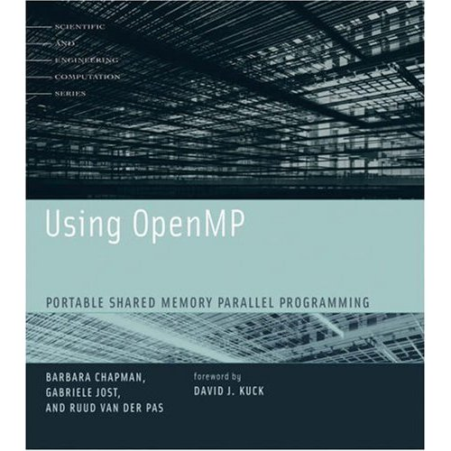

Supplementary Materials
See online tutorial at www.openmp.org
Oracle® Solaris Studio 12.4: OpenMP API User's Guide
SC (Supercomputing) Booth Talks, Presentations and Tutorials
https://www.openmp.org/resources/openmp-presentations/
https://www.openmp.org/resources/tutorials-articles/
“Using OpenMP” book
Chapman, Jost, and Van Der Past

Slide 8

Getting Our Feet Wet

Slide 9
User Interface Model
Shared Memory with thread-based parallelism
Not a new language
Compiler directives, library calls and environment variables extend the base language
C, C++, f77, f90, f95,
Not automatic parallelization
User explicitly specifies parallel execution
compiler does not ignore user directives even if wrong

Slide 10
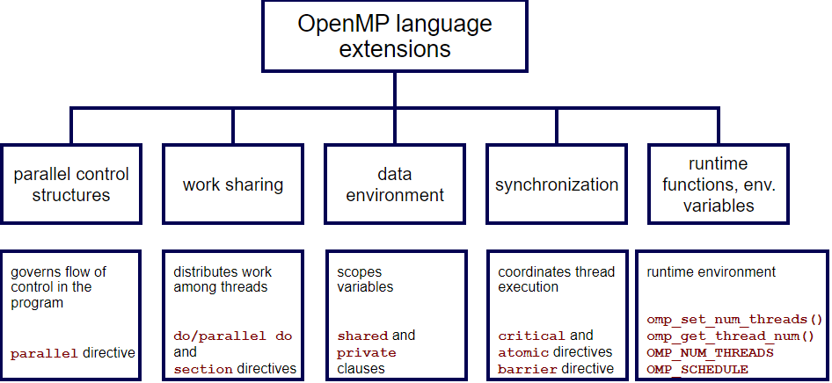
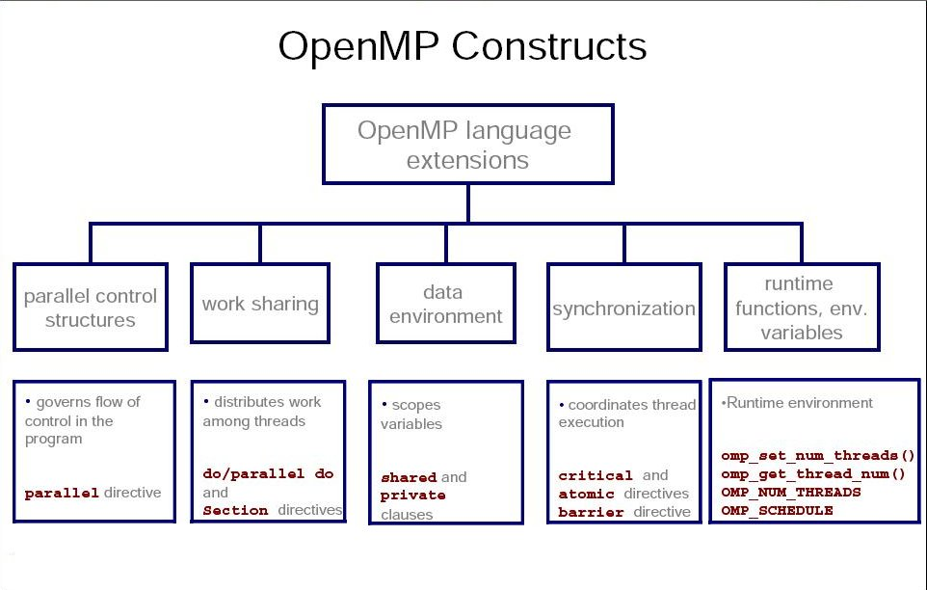
OpenMP Structures
Compiler directive
Run-time functions
Environment variables

Slide 11
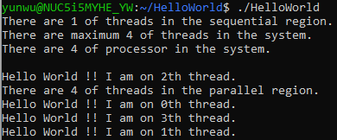
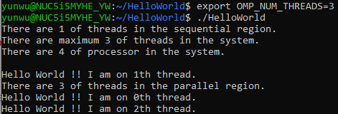
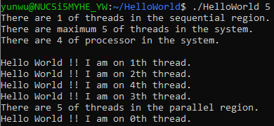
Hello World
#include <stdio.h>
#include <stdlib.h>
#include <omp.h>
int main(int argc, char** argv){
if(argc==2){
int tnum = atoi(argv[1]);
omp_set_num_threads(tnum);
}
printf("There are %d of threads in the sequential region. \n", omp_get_num_threads());
printf("There are maximum %d of threads in the system. \n", omp_get_max_threads());
printf("There are %d of processor in the system. \n\n", omp_get_num_procs());
#pragma omp parallel
{
int tid = omp_get_thread_num();
if(tid==0)
printf("There are %d of threads in the parallel region. \n",
omp_get_num_threads());
printf("Hello World !! I am on %dth thread. \n", tid);
}
return 0;
}
export OMP_NUM_THREADS 3
omp_set_num_threads(5)

Slide 12
Execution Model
OpenMP program starts single threaded
To create additional threads, user starts a parallel region
Additional threads are launched to create a team
Original (master) thread is part of the team
Threads “go away” at the end of the parallel region: usually sleep or spin
Repeat parallel regions as necessary
Fork-join model

Slide 13
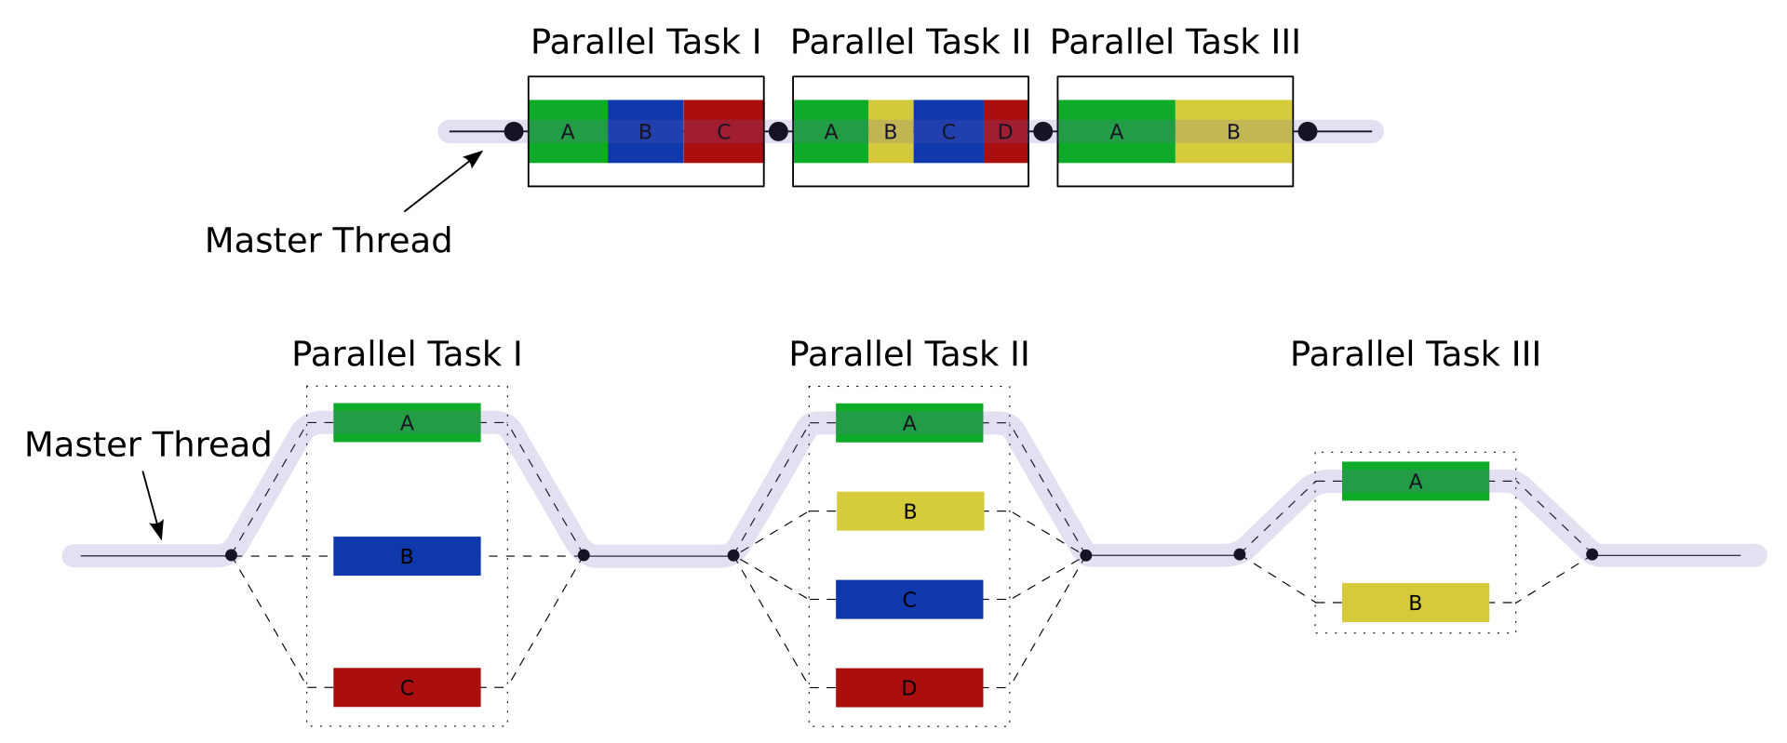
OpenMP Threading

Slide 14
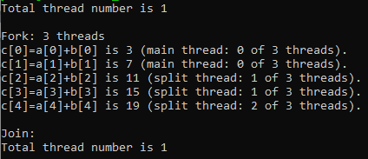
Vector Addition
… …
int i = 0, a[5] = {1, 3, 5, 7, 9}, b[5] = {2, 4, 6, 8, 10}, c[5] = {};
… …
#pragma omp parallel for num_threads(3)
for(i=0;i<5;i++){
c[i] = a[i] + b[i];
… …
}
… …
0
c[0] = a[0] + b[0];
c[1] = a[1] + b[1];
0
1
c[2] = a[2] + b[2];
c[3] = a[3] + b[3];
0
2
c[4] = a[4] + b[4];

Slide 15
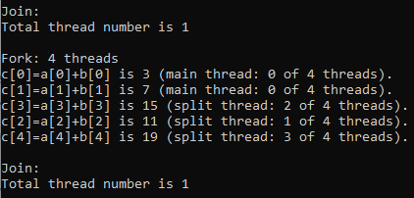
Vector Addition
… …
#pragma omp parallel for num_threads(4)
for(i=0;i<5;i++){
c[i] = a[i] + b[i];
… …
}
… …
0
c[0] = a[0] + b[0];
c[1] = a[1] + b[1];
0
1
0
c[2] = a[2] + b[2];
2
c[3] = a[3] + b[4];
3
c[4] = a[4] + b[4];

Slide 16
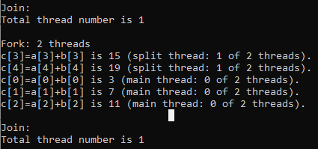
Vector Addition
… …
#pragma omp parallel for num_threads(2)
for(i=0;i<5;i++){
c[i] = a[i] + b[i];
… …
}
… …
1
c[3] = a[3] + b[3]; c[4] = a[4] + b[4];
0
0
c[0] = a[0] + b[0];
c[1] = a[1] + b[1];
c[2] = a[2] + b[2];
0

Slide 17
Storage Model
Shared memory programming model: variables are shared by default
threads read and write shared variables
no need for explicit message passing
Use synchronization to protect against race conditions
Change storage attributes for minimizing synchronization and improving cache reuse
Global variables are shared among threads
C: file scope variables, static
Private Variables:
Exist only within the new scope, i.e. they are uninitialized and
undefined outside the data scope
Loop index variables
Stack variables in sub-programs called from parallel regions

Slide 18
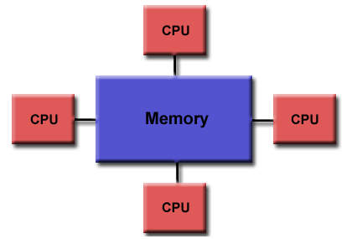
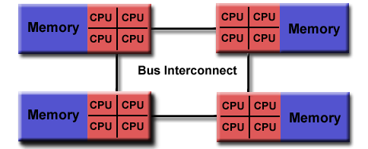
Shared Memory
Uniform Memory Access
Intel 12th Gen Alder Lake Memory Hierachy
Non-Uniform Memory Access

Slide 19
Vector Addition
… …
#pragma omp parallel for num_threads(2)
for(i=0;i<5;i++){
int tid = omp_get_thread_num();
c[i] = a[i] + b[i];
}
… …
Shared over threads
a
b
c
0
1
Independent between threads
2
int func(int a, int b){ int C = A + B; return C;}
… …
#pragma omp parallel num_threads(2)
{
C=func(A, B);
}
… …
3
4

Slide 20
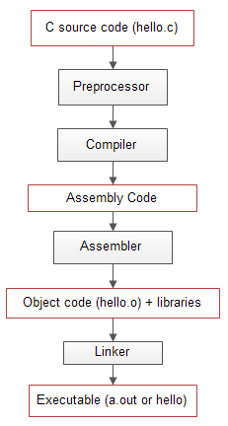




Compilers
No specific Fortran 90 or C++ features are required by the OpenMP specification
Most compilers support OpenMP
Intel (icc, ifort, icpc)
"-openmp"
PGI (pgcc, pgf90, …)
"-mp"
Now in NVIDIA HPC SDK
GNU (gcc, gfortran, g++)
"-fopenmp"
need version 4.2 or later
LLVM with Clang&Clang++
"-fopenmp"

Slide 21
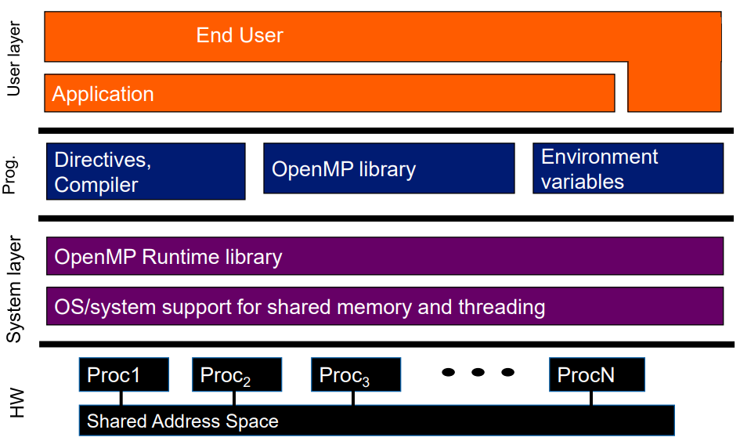
Execution
Microsoft Windows
Microsoft Visual Studio,
Intel Parallel Studio
Unix, Linux
Shell terminal
MacOS
Xcode

Slide 22

Diving In

Slide 23
Work Sharing
for directive
The loop is immediately executed in parallel by the team.
It assumes a parallel region is initiated, or it executes in serial.
section(s) directive
It is non-iterative work-sharing construct.
It divides code among the threads in the team.
single directive
Enclosed code is to be executed by only one thread.
Schedule clause
Specify the workload schedule among threads

Slide 24
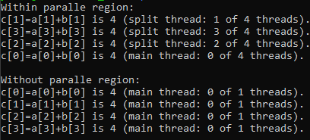
for
……
#pragma omp parallel
{
#pragma omp for
for(i=0;i<LEN;i++){
c[i] = a[i] + b[i];
… …
}
}
……
#pragma omp for
for(i=0;i<LEN;i++){
c[i] = a[i] + b[i];
… …
}

Slide 25
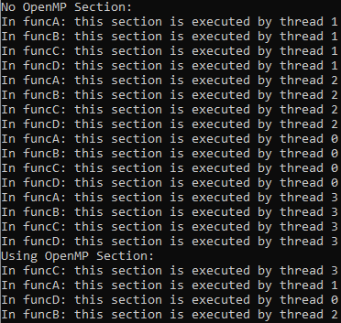
section(s)
… …
#pragma omp parallel sections num_threads(4)
{
#pragma omp section
{
(void)funcA();
}
#pragma omp section
{
(void)funcB();
}
#pragma omp section
{
(void)funcC();
}
#pragma omp section
{
(void)funcD();
}
}
… …

Slide 26
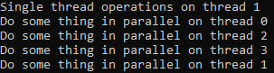
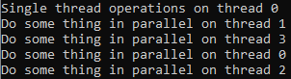
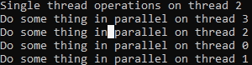
single
#pragma omp parallel num_threads(4)
{
#pragma omp single
{
int i = omp_get_thread_num();
printf("Single thread operations on thread %d\n", i);
}
{
int j = omp_get_thread_num();
printf("Do some thing in parallel on thread %d\n", j);
}
}

Slide 27
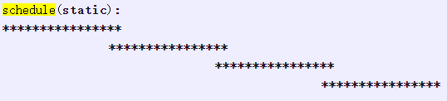
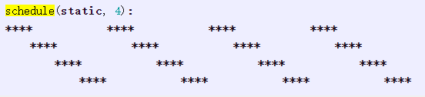
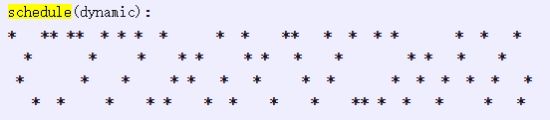
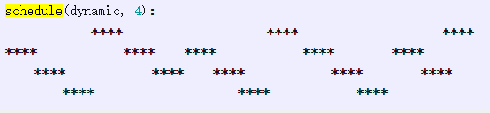
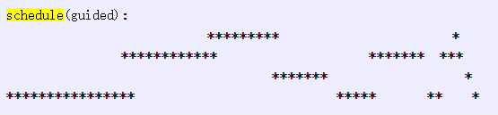
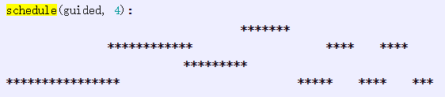
schedule(method, chunk-size)

Slide 28
Data Scoping
private clause: specify the variable to have instances in each thread.
shared clause: specify one or more variables to be shared in each thread
reduction clause: specify the operator for the operation to do on the variables at the end of the parallel region.
default clause: specifies the behavior of unscoped variables in a parallel region.
firstprivate clause: some to private, but variable should be initialized as it is also outside of parallel region.
lastprivate clause: Specifies that the enclosing context's version of the variable is set equal to the private version of whichever thread executes the final iteration (for-loop construct) or last section (#pragma sections).
copyin clause: Allows threads to access the master thread's value, for a threadprivate variable
copyprivate clause: Specifies that one or more variables should be shared among all threads
etc.

Slide 29
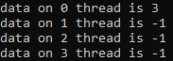
private
… …
int nPrivate=4;
#pragma omp parallel private(nPrivate)
{
#pragma omp for
for(i=0;i<4;i++){
int tid = omp_get_thread_num();
nPrivate --;
nSave[tid] = nPrivate;
}
}
… …

Slide 30
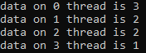
shared
… …
int nShared=4;
#pragma omp parallel shared(nShared)
{
#pragma omp for
for(i=0;i<4;i++){
int tid = omp_get_thread_num();
nShared --;
nSave[tid] = nShared;
}
}
… …

Slide 31
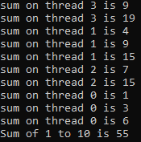
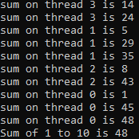
reduction
… …
int i, sum=0;
omp_set_num_threads(4);
#pragma omp parallel
{
#pragma omp for reduction(+:sum)
for(i=1;i<=10;i++){
int tid = omp_get_thread_num();
sum+=i;
… …
}
} … …
… …
int i, sum=0;
omp_set_num_threads(4);
#pragma omp parallel
{
#pragma omp for
for(i=1;i<=10;i++){
int tid = omp_get_thread_num();
sum+=i;
… …
}
} … …

Slide 32
Synchronization
critical directive: must be executed by only one thread at a time
barrier directive: wait till all threads reached the barrier and then resume
atomic directive: specific memory location must be updated atomically
master directive: executed only by the master thread
flush directive: a synchronization point where the implementation must provide a consistent view of memory
ordered directive: iterations of the enclosed loop will be executed in the same order as if they were executed on a serial processor.
etc.

Slide 33
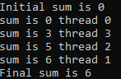
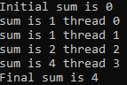
critical
… …
int sum = 0;
……
#pragma omp parallel num_threads(4)
{
int tid = omp_get_thread_num();
#pragma omp critical
{
sum += tid;
… …
}
}
… …
… …
int sum = 0;
……
#pragma omp parallel num_threads(4)
{
int tid = omp_get_thread_num(); sum += tid;
… …
}
… …

Slide 34
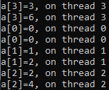
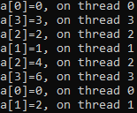
barrier
… …
int a[5]={0,0,0,0,0};
#pragma omp parallel num_threads(4)
{
int tid = omp_get_thread_num();
a[tid] = tid;
a[tid] += tid;
… …
}
… …
… …
int a[5]={0,0,0,0,0};
#pragma omp parallel num_threads(4)
{
int tid = omp_get_thread_num();
a[tid] = tid;
#pragma omp barrier
a[tid] += tid;
… …
}
… …

Slide 35
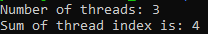
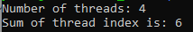
atomic
… …
int sharedmem = 0;
int count = 0;
#pragma omp parallel num_threads(MAX)
{
int tid = omp_get_thread_num();
#pragma omp atomic
sharedmem += tid;
#pragma omp atomic
count++;
}
… …
… …
int sharedmem = 0;
int count = 0;
#pragma omp parallel num_threads(MAX)
{
int tid = omp_get_thread_num();
sharedmem += tid;
count++;
}
… …

Slide 36
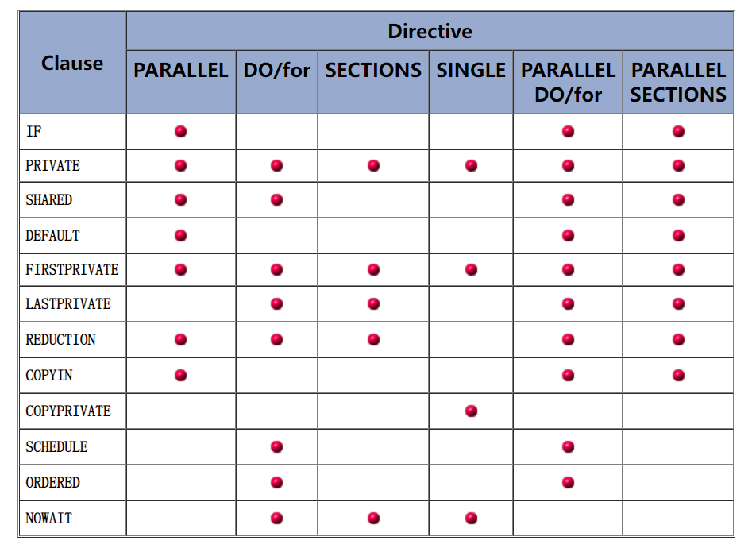
Directive and Clause Summery
Not all the clause can be used for every directive.
Most clause are used for specify attributes of parallelism, schedule, and variable memory locations.
All directive and clause guide the compiler to explicitly transform the sequential code into parallel version

Slide 37
Runtime Control
omp_set_num_threads(integer): set the number of parallel thread
omp_get_num_threads: get the number of thread in current region
omp_get_num_procs: get the number of processor
omp_in_parallel: check if current region is executed in parallel
omp_set_dynamic (integer): set number of thread to be adjusted by the runtime in the upcoming parallel region
omp_get_dynamic: get number of thread be adjusted by the runtime in the upcoming parallel region
omp_set_nested(integer): set the level of nested parallelism
omp_get_nested: check if the parallel region is nested
etc.

Slide 38
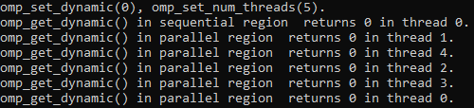
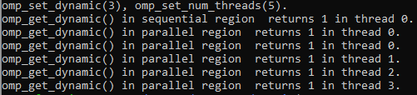
Runtime example
… …
omp_set_dynamic(0);
omp_set_num_threads(5);
printf("omp_set_dynamic(%d), omp_set_num_threads(5).\n", num_dym);
printf("omp_get_dynamic() in sequential region returns %d "
"in thread %d.\n", omp_get_dynamic(), omp_get_thread_num());
#pragma omp parallel
{
#pragma omp for
for(i=0;i<5;i++){
printf("omp_get_dynamic() in parallel region returns %d "
"in thread %d.\n", omp_get_dynamic( ), omp_get_thread_num());
}
}
… …
… …
omp_set_dynamic(3);
omp_set_num_threads(5);
printf("omp_set_dynamic(%d), omp_set_num_threads(5).\n", num_dym);
printf("omp_get_dynamic() in sequential region returns %d "
"in thread %d.\n", omp_get_dynamic(), omp_get_thread_num());
#pragma omp parallel
{
#pragma omp for
for(i=0;i<5;i++){
printf("omp_get_dynamic() in parallel region returns %d "
"in thread %d.\n", omp_get_dynamic( ), omp_get_thread_num());
}
}
… …

Slide 39


Profiling
There are many C/C++ performance profilers:
Perf, gprof
TAU,
ARM MAP
Google orbit
Intel® VTune™ Profiler
etc.
For this course, we mostly concern the processing time speedup from sequential to parallel code, e.g. using omp_get_wtime().

Slide 40
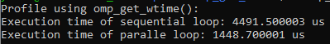
omp_get_wtime
… …
double start = omp_get_wtime();
usleep(1000);
usleep(1000);
usleep(1000);
usleep(1000);
double stop = omp_get_wtime();
… …
… …
start = omp_get_wtime();
#pragma omp parallel sections
{
#pragma omp section
{
usleep(1000);
}
#pragma omp section
{
usleep(1000);
}
#pragma omp section
{
usleep(1000);
}
#pragma omp section
{
usleep(1000);
}
}
stop = omp_get_wtime();
… …

Slide 41
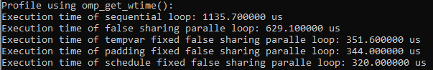
Optimization - False Sharing
Sequential
Naive OMP parallel
... ...
#define LEN 16384
#define LOOP 1000
int C[LEN];
double start = omp_get_wtime();
for(i=0;i<LEN;i++){
for(j=0;j<LOOP;j++){
C[i] += C[i] + i;
}
}
double stop = omp_get_wtime();
time_spent = (double)(stop - start)*1000*1000;
printf("Execution time of sequential loop: %lf us\n", time_spent);
... ...
... ...
start = omp_get_wtime();
#pragma omp parallel
{
#pragma omp for
for(i=0;i<LEN;i++){
for(j=0;j<LOOP;j++){
C[i] += C[i] + i;
}
}
}
stop = omp_get_wtime();
time_spent = (double)(stop - start)*1000*1000;
printf("Execution time of sequential loop: %lf us\n", time_spent);
... ...
The false sharing depends on the architecture !

Slide 42
Avoid False Sharing
Using private variables
Padding the array
Using trunky schedule
... ...
#pragma omp parallel shared(C)
{
#pragma omp for private(i, j)
for(i=0;i<LEN;i++){
int tmp = C[i];
for(j=0;j<LOOP;j++)
tmp += tmp + i;
C[i] = tmp;
}
}
... ...
… …
int C_PAD[LEN*16];
... ...
#pragma omp parallel shared(C)
{
#pragma omp for private(i, j)
for(i=0;i<LEN;i++)
for(j=0;j<LOOP;j++)
C_PAD[i*16] += C_PAD[i*16] + i;
}
... ...
... ...
#pragma omp parallel shared(C)
{
#pragma omp for private(i, j) schedule(static, 16)
for(i=0;i<LEN;i++)
for(j=0;j<LOOP;j++)
C[i] += C[i] + i;
}... ...
More information on
https://hpc-wiki.info/hpc/OpenMP_in_Small_Bites/False_Sharing

Slide 43

Swimming Like a Champion

Slide 44
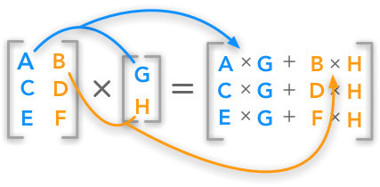
Matrix Vector Multiplication
c = A * b;
… …
for (i = 0; i < ROW; ++i) {
sum = 0 ;
for (j = 0; j < COL; ++j){
sum += A[i][j]*b[j];
c[i] = sum;
}
}
… …

Slide 45
Sequential to Parallel
… …
int i=0, j=0;
#pragma omp parallel
{
#pragma omp for
for (i = 0; i < ROW; ++i) {
c1[i] = 0 ;
for (j = 0; j < COL; ++j){
c1[i] += A[i][j]*b[j];
}
}
}
Any problems ?

Slide 46
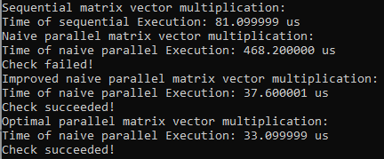
Optimizing Parallel Region
… …
#pragma omp parallel shared(A,b,c) private(i,j)
{
#pragma omp for
for (i = 0; i < ROW; ++i) {
c1[i] = 0 ;
for (j = 0; j < COL; ++j){
c1[i] += A[i][j]*b[j];
}
}
}
… …
… …
#pragma omp parallel shared(A,b,c) private(i,j)
{
#pragma omp for schedule(static) nowait
for (i = 0; i < ROW; ++i) {
int sum = 0;
for (j = 0; j < COL; ++j){
int mul = += A[i][j]*b[j];
sum += mul;
}
#pragma omp atomic
c2[i] += sum;
}
}
… …
Avoid competition of memory access
Avoid false sharing with scheduled loop trunk size

Slide 47
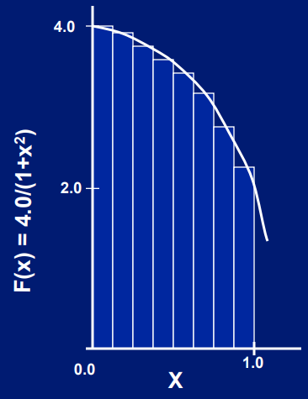
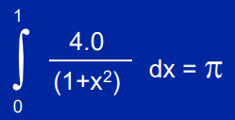
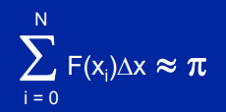
Approximation of π
Mathematically, π can be derived by
We can approximate the integral as a sum of rectangles:
where each rectangle has width Δx and height F(x_{i}) at the middle of interval i.

Slide 48
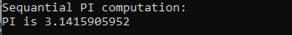
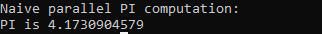
Sequential to Parallel
… …
float sum = 0, pi;
float step = 1.0 / (float)num_steps;
for (i = 0; i < num_steps; ++i) {
float x = (i + 0.5) * step;
float aux = 4.0 / (1.0 + x * x);
sum += aux;
}
pi = step * sum;
… …
… …
#pragma omp parallel for
for (i = 0; i < num_steps; ++i) {
float x = (i + 0.5) * step;
float aux = 4.0 / (1.0 + x * x);
sum += aux;
}
pi = step * sum;
… …
Any problems ?

Slide 49
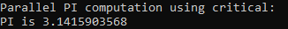
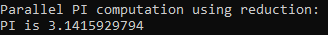
Optimizing Parallel Region
… …
#pragma omp parallel private(i) shared(sum)
{
#pragma omp for schedule(static, 1)
for (i=0; i<num_steps; ++i){
float x = (i + 0.5) * step;
float aux = 4.0 / (1.0 + x * x);
#pragma omp critical
sum += aux;
}
}
pi = step * sum;
… …
… …
#pragma omp parallel private(i) shared(sum)
{
#pragma omp for reduction(+:sum) schedule(static, 1)
for (i=0; i<num_steps; ++i){
float x = (i + 0.5) * step;
float aux = 4.0 / (1.0 + x * x);
#pragma omp atomic
sum += aux;
}
}
pi = step * sum;
… …
Schedule the memory access of specific operation on variable
Synchronize the data with automatic updated memory location

Slide 50
Advanced Topics Above OpenMP 4.0
Task: enables parallel region as tasks to be queued and executed as schedule
“On the Performance of Parallel Tasking Runtimes for an Irregular Fast Multipole Method Application”, Patrick Atkinson, etc., 2017
Target: enables parallel threads to be distributed to Nvidia GPU
“Evaluating OpenMP 4.0's Effectiveness as a Heterogeneous Parallel Programming Model”, Matt Martineau, etc., 2016.

Slide 51

Target on Devices

Slide 52

See you in OpenCL

